Slide 1
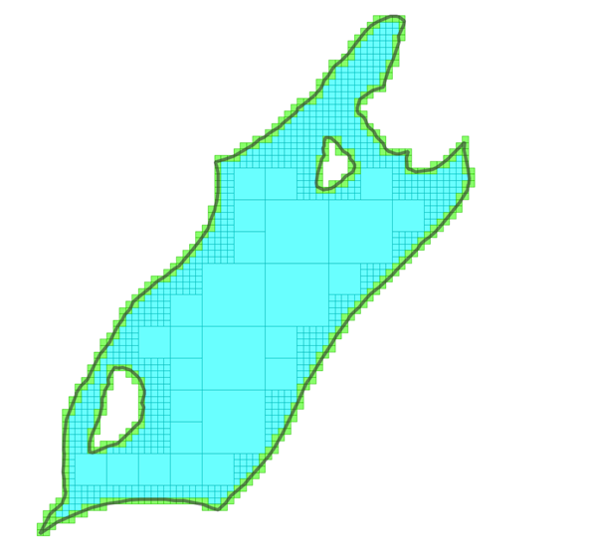
RADIG: Resolution-Adaptive Digit Interleaving Grid for multi-resolution grid index
Sheng Zhou
Senior Data Scientist
Data Science & Analytics
Chief Geospatial Office
Ordnance Survey

Slide 2
BNG grid reference as a spatial indexing method
Easy to interpret (by human) and efficient
Fundamental issues:
Fixed resolution for all features in a dataset
Huge challenge on selecting an appropriate resolution for dataset with vast feature size variation
Two datasets to be joined have to be indexed at the same resolution

Slide 3
Resolution-Adaptive Digit Interleaving Grid (RADIG)
A framework to tackle the multi-resolution grid reference problem
References at different resolutions in the same dataset
Mixed resolution references for the same feature
Joining two datasets with references at mixed resolutions (provided they are indexed under the same RADIG)
Using Digit Interleaving encoding to represent resolution hierarchy in reference string

Slide 4
Digit Interleaving: BNG vs RADIG as a practical example
A sample BNG coordinate: 562356, 231722
BNG Grid references at different resolution (interleaving + concatenation) : TL->TL63->TL6231->TL623317-> TL62353172->TL6235671322
RADIG aligned to BNG and using digit interleaving encoding: TL->TL63->TL6321->TL632137->TL63213752->TL6321375262
Digit Interleaving: 5 6 2 3 5 6, 2 3 1 7 2 2 Digit Concat: 5 6 2 3 5 6, 2 3 1 7 2 2
RADIG Ref: T L 6 3 2 1 3 7 5 2 6 2 BNG Ref: T L 6 2 3 5 6 3 1 7 2 2

Slide 5
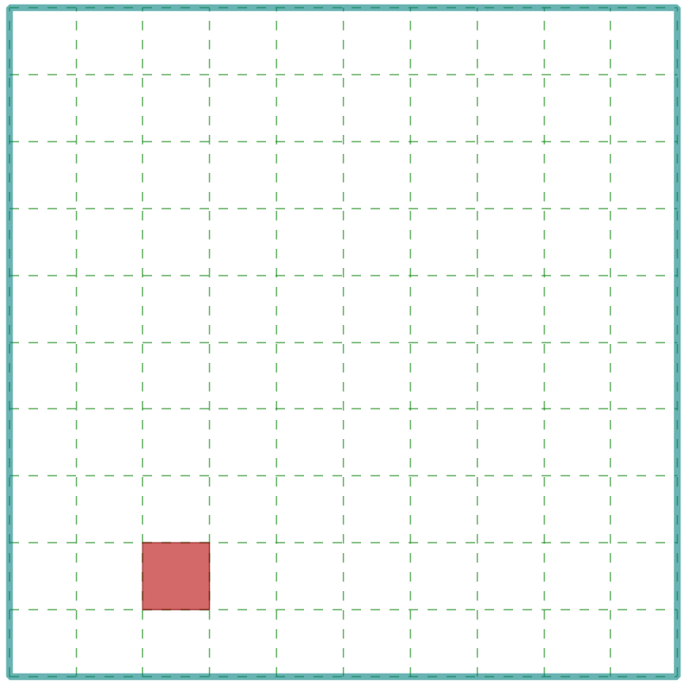
Digit Interleaved RADIG Reference for Multi-Resolution Process
Grid cell hierarchy represented by the order of digits in digit interleaving references:
Ref Series for (562356, 231722): TL->TL63->TL6321->TL632137->TL63213752->TL6321375262
Grid_Cell(TL).contains(Grid_Cell(TL63)) <=> “TL63”.startsWith(“TL”) == True
Grid_Cell(TL63).contains(Grid_Cell(TL6321) <=> “TL6321”.startsWith(“TL63”) == True
And so on…
Original BNG: TL63 vs TL6231 (not sub-stringing)
TL63
TL6321

Slide 6
Grid Cell Containment/Intersection by Substring Operations
Containment
containDF = dfFeat.join(dfQry, dfFeat.RadigRef.startsWith(dfQry.RadigRef))
Intersection
interDF = df1.join(df2, df1.RadigRef.startsWith(df2.RadigRef) | df2.RadigRef.startsWith(df1.RadigRef))

Slide 7
Sub-stringing: Performance Issue
StartsWith()
Many DBMS don’t have it
Some have it, but not optimised
In Spark SQL, the call is translated to a cross-join

Slide 8
RADIG Prefix Matching
…
S
T
U
…
…
G
L
M
…
BNG References Matching
String comparison, merge-sort, efficient
RADIG Reference Matching
May be performed using standard SQL query
Prefix matching, not necessarily optimised in all DBMS and may have performance issue
Potential solution: Multi-way Trie (Prefix tree) index for RADIG reference values
Example: TL6321375262
…
5
6
7
…
…
2
3
4
…
…
1
2
3
…
…
0
1
2
…
…
2
3
4
…
…
6
7
8
…
…
4
5
6
…
…
1
2
3
…
…
5
6
7
…
…
1
2
3
…

Slide 9
RADIG Match Trie
…
S
T
U
…
…
G
L
M
…
Given query reference TL6321
Drill down from top of the Trie per digit
First matching node (red cycle) and all its children (inside the dashed box) are the result
Joining two RADIG Match Tries:
Synchronised traversal
Traverse on one Trie, visit corresponding node on the other
Time complexity: O(amN) (a: the ave. key length; m: the alphabet size; N : the max Trie size)
…
5
6
7
…
…
2
3
4
…
…
1
2
3
…
…
0
1
2
…
…
2
3
4
…
…
6
7
8
…
…
4
5
6
…
…
1
2
3
…
…
5
6
7
…
…
1
2
3
…

Slide 10
Scalable RADIG Match Trie
Partition and Conquer: two approaches
Partition by object keys
Partition of key space

Slide 11
RADIG Prefix Matching (3)
On distributed systems such as Spark in Databricks
Partition Scheme:
Regular Grid (simple, good for evenly distributed data)
RADIG Partition Trie (Adaptive to data distribution, more complicated, may have no gain?)
Matching:
RADIG Match Trie: efficient, needs more memory
RADIG Reference SubStringing: simple, but not as efficient

Slide 12
Dynamic Generation of Grid References Adaptive to Feature Extent
Polygon feature as an example
Start at a large resolution (equal or larger than the extent of the feature)
Test “effective area” value (proportion of cell intersecting the feature)
If ratio higher than predefined threshold, return the reference of this grid cell
Otherwise, sub-divide the cell, goes to next finer resolution to repeat the test
Also controlled by a cut-off minimum resolution, and a maximum levels of sub-division

Slide 13
Flow Chart for RADIG Reference Generation
Pure digit-string output
BNG-style as a customised instance
Support encoding in different radix number systems (e.g. base10, 2, 8, 16)
Currently implemented in Java, with Scala wrappers for Databricks
Further details in the technical report
Encoding prefix
Dual Divisors to improve resolution granularity and support the 5x tiles
Grid Spec.
(G, B, I, D)
geometry
Acquire Initial Resolution and generate RADIG
Test Cell-geometry intersection
Intersects?
Recycle cell
Compute EA/EL
Result
Output reference
Above threshold or reach level/res limit
Cell sub-division

Slide 14
Mosaic vs RADIG: Space Utilisation
Sample data: Topobase landformArea (30km x 30km) with 1190 features
 | Parameter | Reference count | Total grid cell aera | Largest cell edge length
BNG (Mosaic) | Optimal Res = -6(5.0m) | 66238 | 1652230.0 | 5
BNGRadig | DivLevel = 15, minRes = 5.0, ea = 0.5 | 38281 | 1725418.0 | 100
BNGRadig | DivLevel = 15, minRes = 5.0, ea = 0.8 | 50993 | 1653578.0 | 50
BNGRadig | DivLevel = 15, minRes=5.0, ea = 1.0 | 58932 | 1652328.0 | 50

Slide 15
Mosaic vs RADIG: Running Time
Dataset: 40298590 address points vs 14767492 building polygons (Z-Order optimised when applicable)
 | time | Note 1 | Note 2
Mosaic | 1.81min
RADIG Match Trie | 4.51min
RADIG Ref SubStringing | 3.36min | One-way match | Only applicable for point-in-polygon
RADIG Ref SubStringing | 10.9min | Two-way match

Slide 16
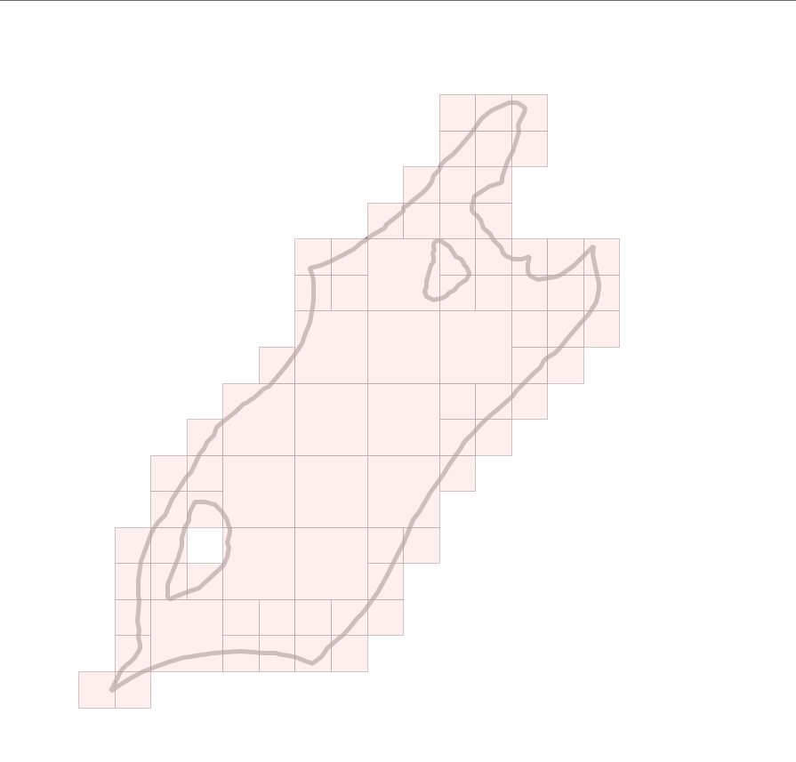
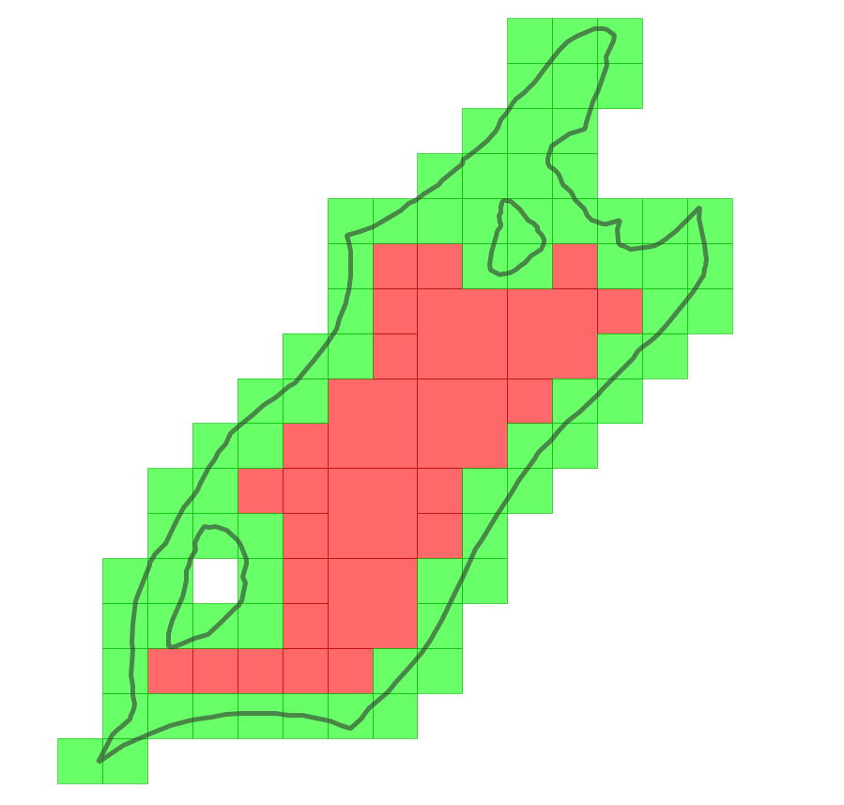
Sample RADIG Outputs (1)
Base-10, 2 divisors (2X5), max level 4, area ratio 0.8
Base-10, divisor 2x5, max level 4, area ratio 0.8, containing cells are separated

Slide 17
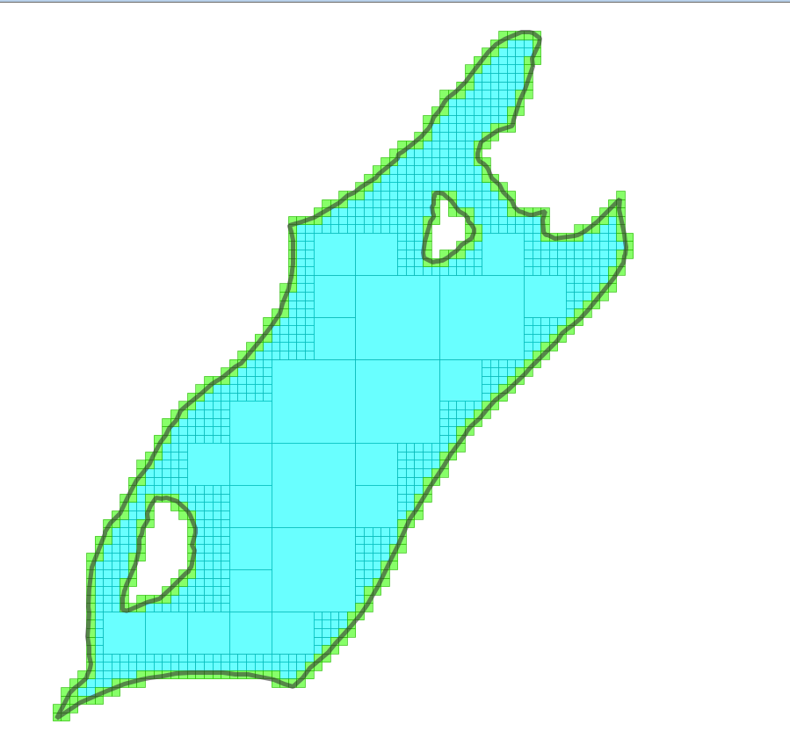
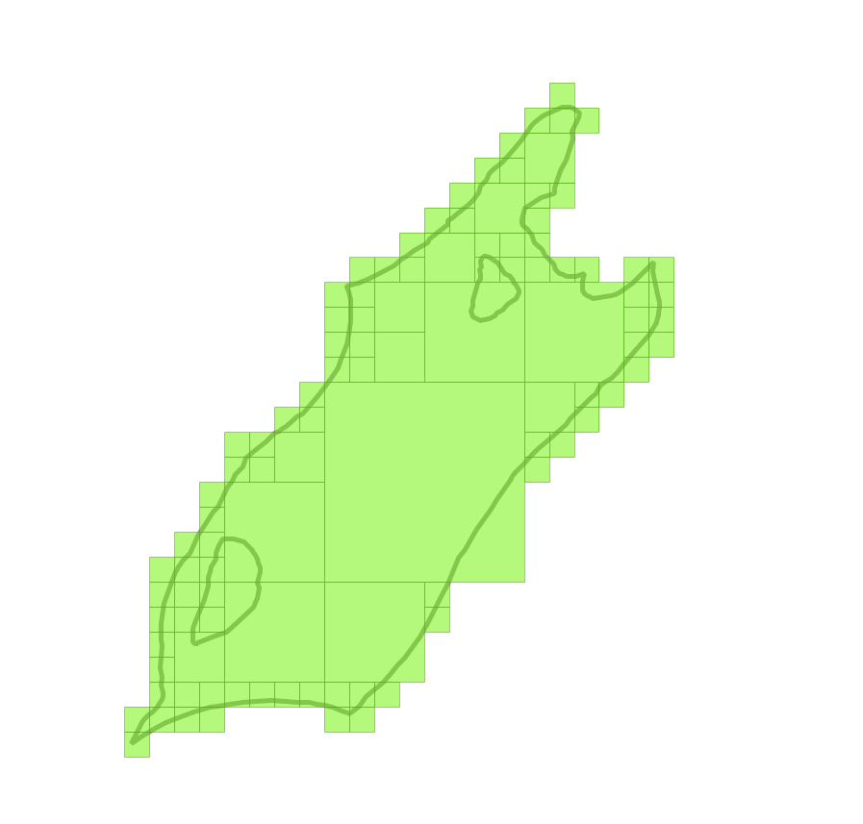
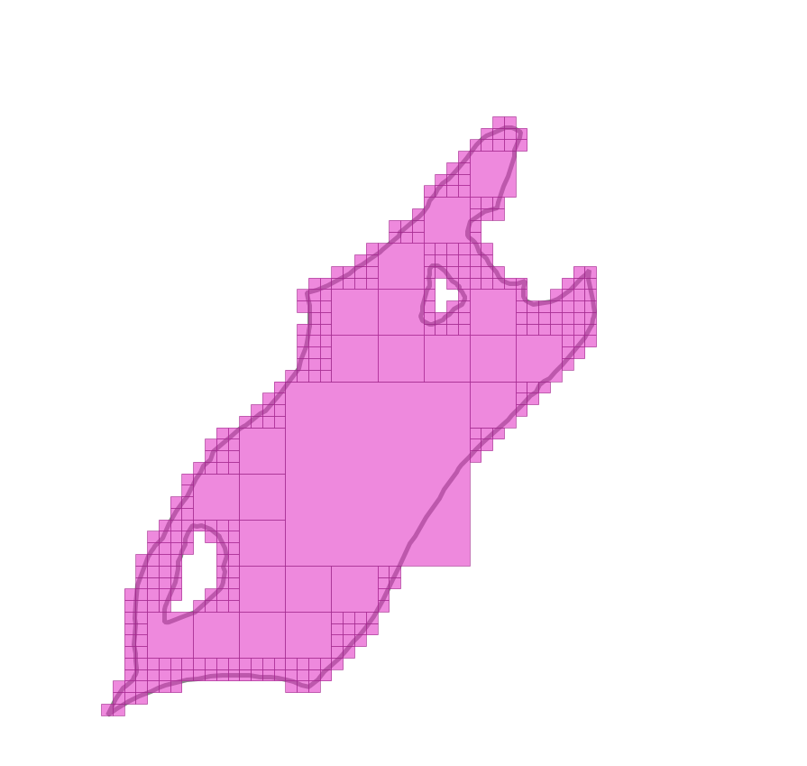
Sample RADIG Outputs (2)
Base-10, max level 5, 2x5 divisor
Base-2, max level 6
Base-16, max level 4, 4x4 divisors

